Slide 1
Defensive Security Project
by: Orlando Guerra

Slide 2
Table of Contents
This document contains the following resources:
Monitoring Environment
Attack Analysis
Project Summary & Future Mitigations

Slide 3

Monitoring Environment
‹#›

Slide 4
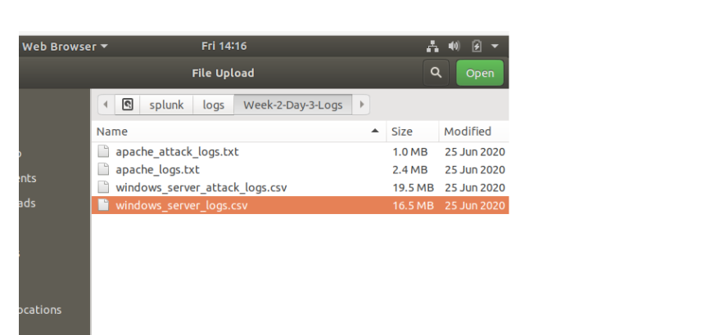
Scenario
Once Splunk was started we uploaded Windows Server Logs and Apache Server Logs to Analyze them.
Using SPL we created reports, alerts, and dashboards for the Windows logs.
Reports, alerts, and dashboards were also created for Apache server logs.
Visualizations were made to easily demonstrate the analyzed logs.
By installing additional Splunk Add-on applications we are able to provide
additional monitoring.
Lastly through comparing the attack logs to their respective server logs.

Slide 5
[“Add-On” App]
‹#›

Slide 6
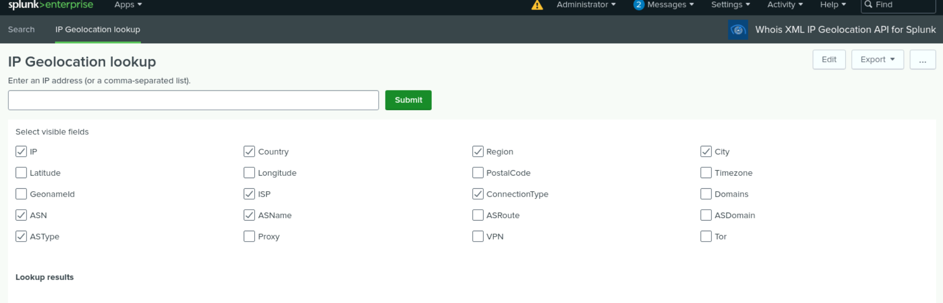
Whois XML IP Geolocation API for Splunk
IP Geolocation API service allows you to identify your web visitors and users’ geographical location. IP location helps customize web experiences, prevent fraud, ensure regulatory compliance, and more. apps.splunk.com/app/5299
Using this API we are able to pinpoint a region, country, or coordinates of a specific IP Address or multiple. Making it easier to provide location data for enhancing user experience and mitigating security risks.

Slide 7
Logs Analyzed
Windows Logs
Apache Logs
1
2
Contain Signature Fields and IDs for signatures
Contain Username logs
Contain Server Status logs
Contain Server level severity information
Contains HTTP method activity
HTTP Domain logs
HTTP response code logs
Client IP’s as well as their locations
User Agent information

Slide 8
Windows Logs
‹#›

Slide 9
Reports—Windows
Designed the following reports:
Report Name | Report Description
Windows_server_logs_signatures_signatureids | Report with table of specific signatures and associated signature ids for Windows activities.
Windows_log_status | Report that shows success and failures of Windows activites
Windows_log_severity | Report that shows severity levels of Windows logs based on Informational or High value.

Slide 10
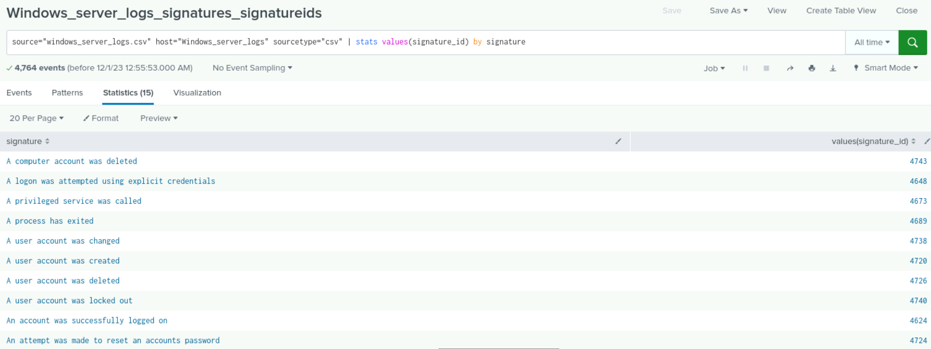
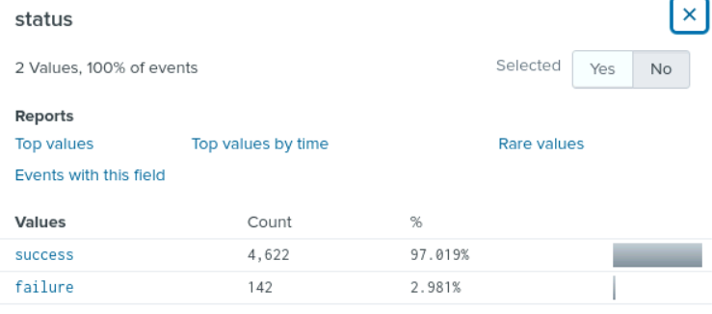
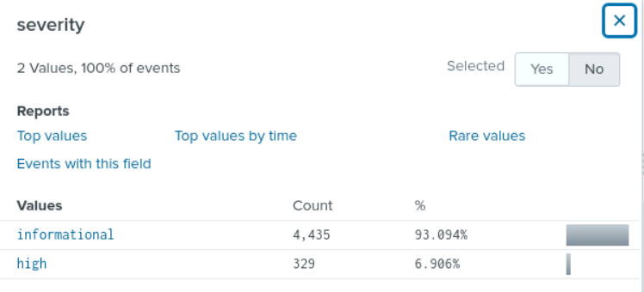
Images of Reports—Windows
Report Image

Slide 11
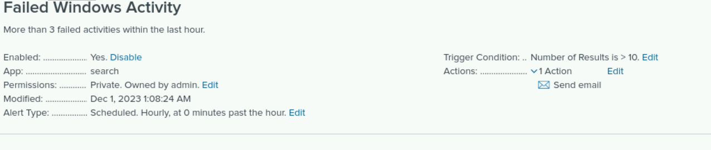
Alerts—Windows
Designed the following alerts:
Alert Name | Alert Description | Alert Baseline | Alert Threshold
Failed Windows Activity | The number of failed requests is beyond what is allowed | 5 | 10
JUSTIFICATION: I choose this baseline and threshold based on the fact that the number of failed activities does not exceed 6 every 30 minutes.

Slide 12
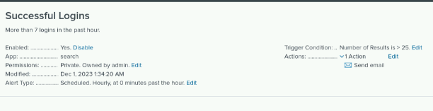
Alerts—Windows
Designed the following alerts:
Alert Name | Alert Description | Alert Baseline | Alert Threshold
Successful Logins | Too many successful logins have been made in the span of an hour | 12 | 25
JUSTIFICATION: Successful logins are very common within a network and too many logins can be a sign of unusual activities going on. A baseline of 12 sets a very normal amount of logins per hour, While the threshold of 25 allows for us to know that there is a login every two minutes.

Slide 13
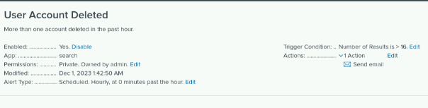
Alerts—Windows
Designed the following alerts:
Alert Name | Alert Description | Alert Baseline | Alert Threshold
User Account Deleted | The number of user accounts that have been deleted is unusual. | 10 | 16
JUSTIFICATION: Accounts being deleted in the system is not uncommon from as low as 6 deleted per hour to 10 or more. During several hours of the day there seems to be almost 20 accounts deleted per hour and this can be seen as suspicious.

Slide 14
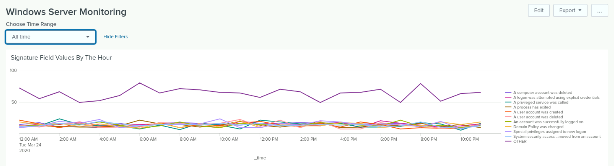
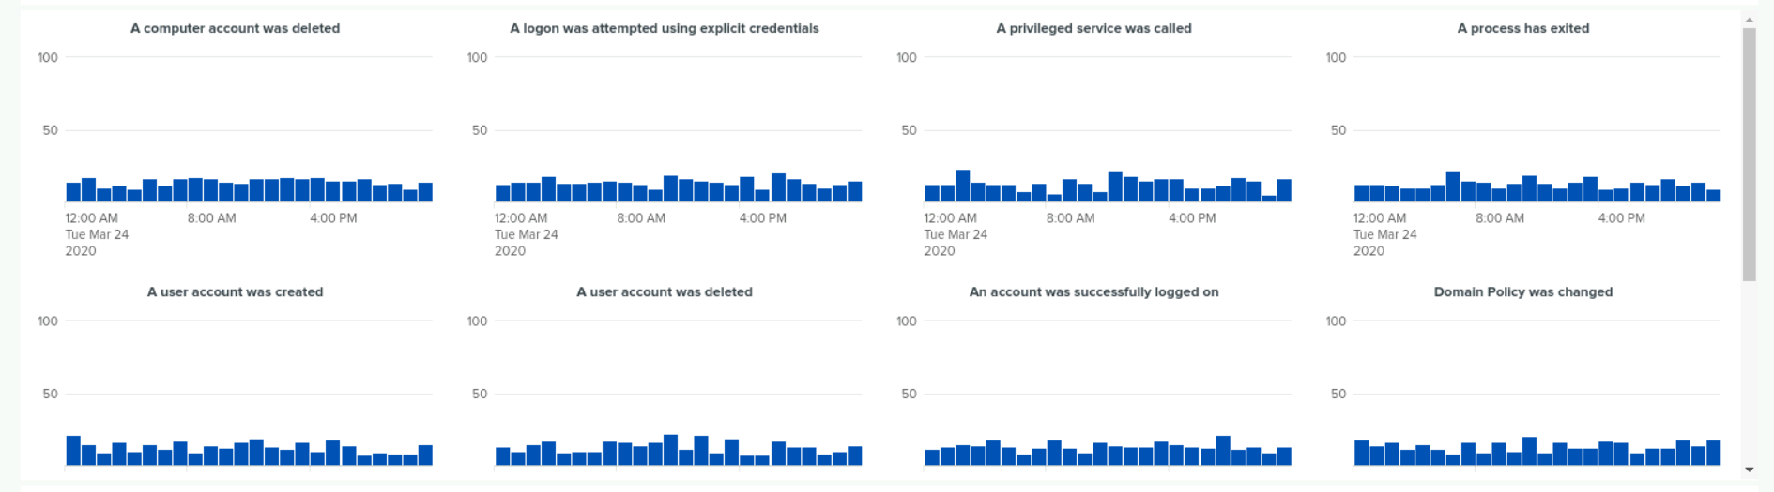
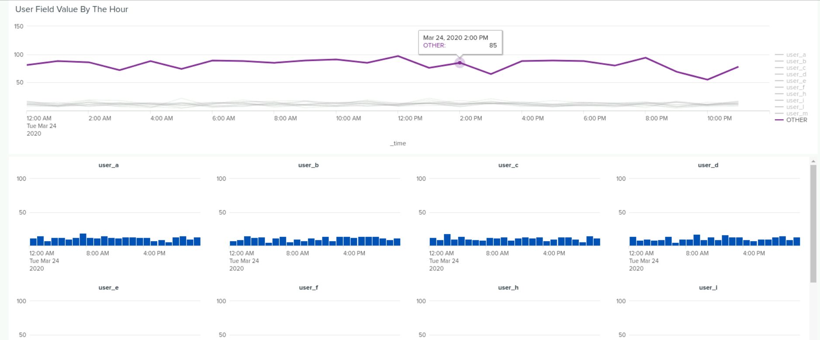
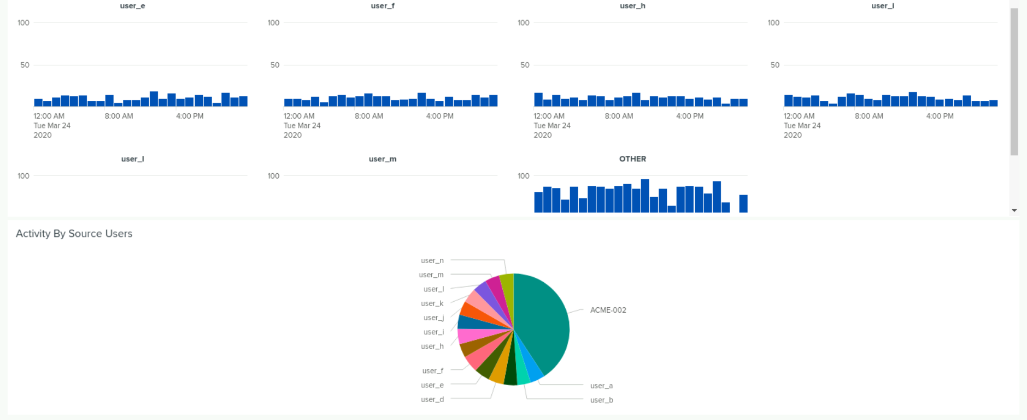
Dashboards—Windows
Place image here
Place image here
Place image here
Place image here
The Windows Server Monitoring Dashboard that was constructed.

Slide 15
Apache Logs
‹#›

Slide 16
Reports—Apache
Designed the following reports:
Report Name | Report Description
HTTP Methods and Web Servers | Report that shows different HTTP method requests
Top 10 Domains and Top IP’s | Report showing referrer domains with most common IP’s in server
HTTP Response Codes | Report showing counts of HTTP response to server requests

Slide 17
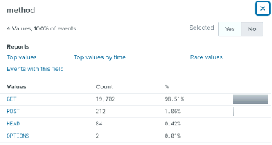
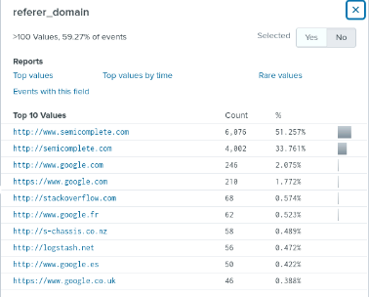
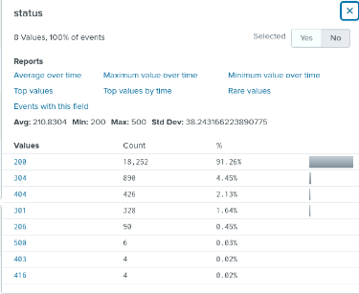
Images of Reports—Apache

Slide 18
Alerts—Apache
Designed the following alerts:
Alert Name | Alert Description | Alert Baseline | Alert Threshold
Hourly_Activity_Int | Alerts on location based actvity | 2 | 10
JUSTIFICATION: As we do not see outstanding activity from external Locations outside the US, we should believe we will get an overflow of traffic.

Slide 19
Alerts—Apache
Designed the following alerts:
Alert Name | Alert Description | Alert Baseline | Alert Threshold
HTTP_POST_THRESHOLD | An hourly count of the HTTP POST Method | 2 | 7
JUSTIFICATION: This will allow us to be alerted in the event of a substantial amount of POST method usage.

Slide 20
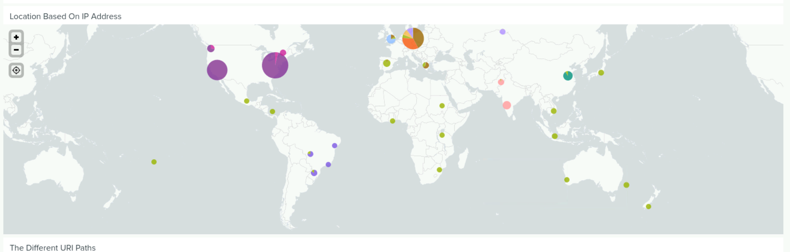
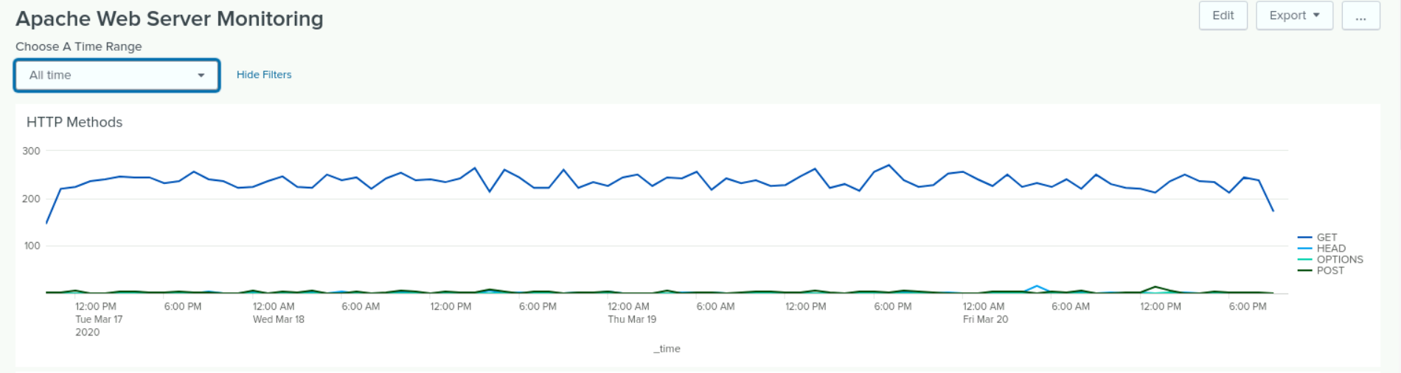
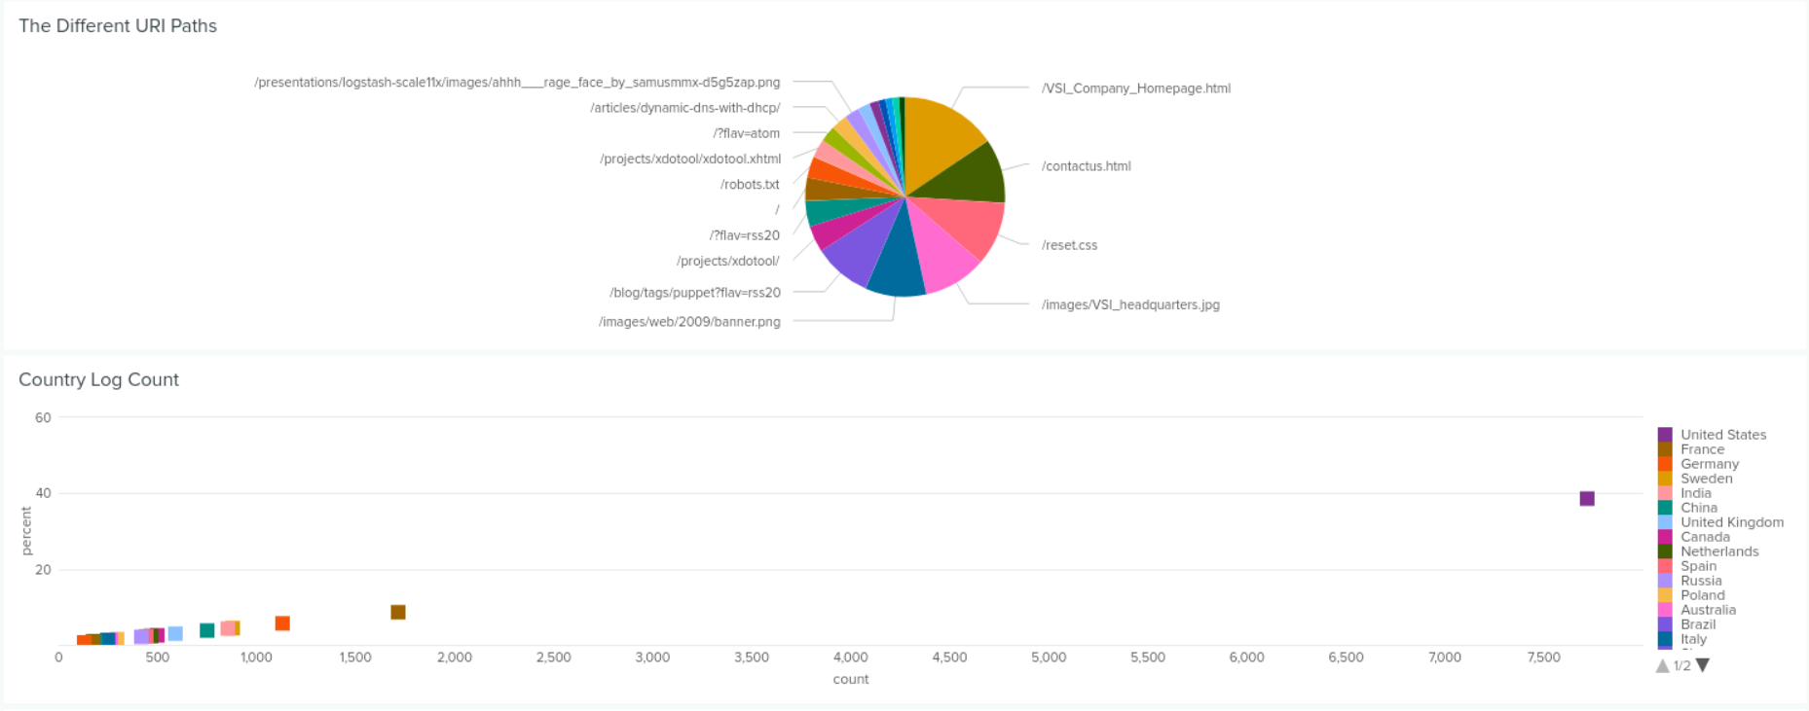
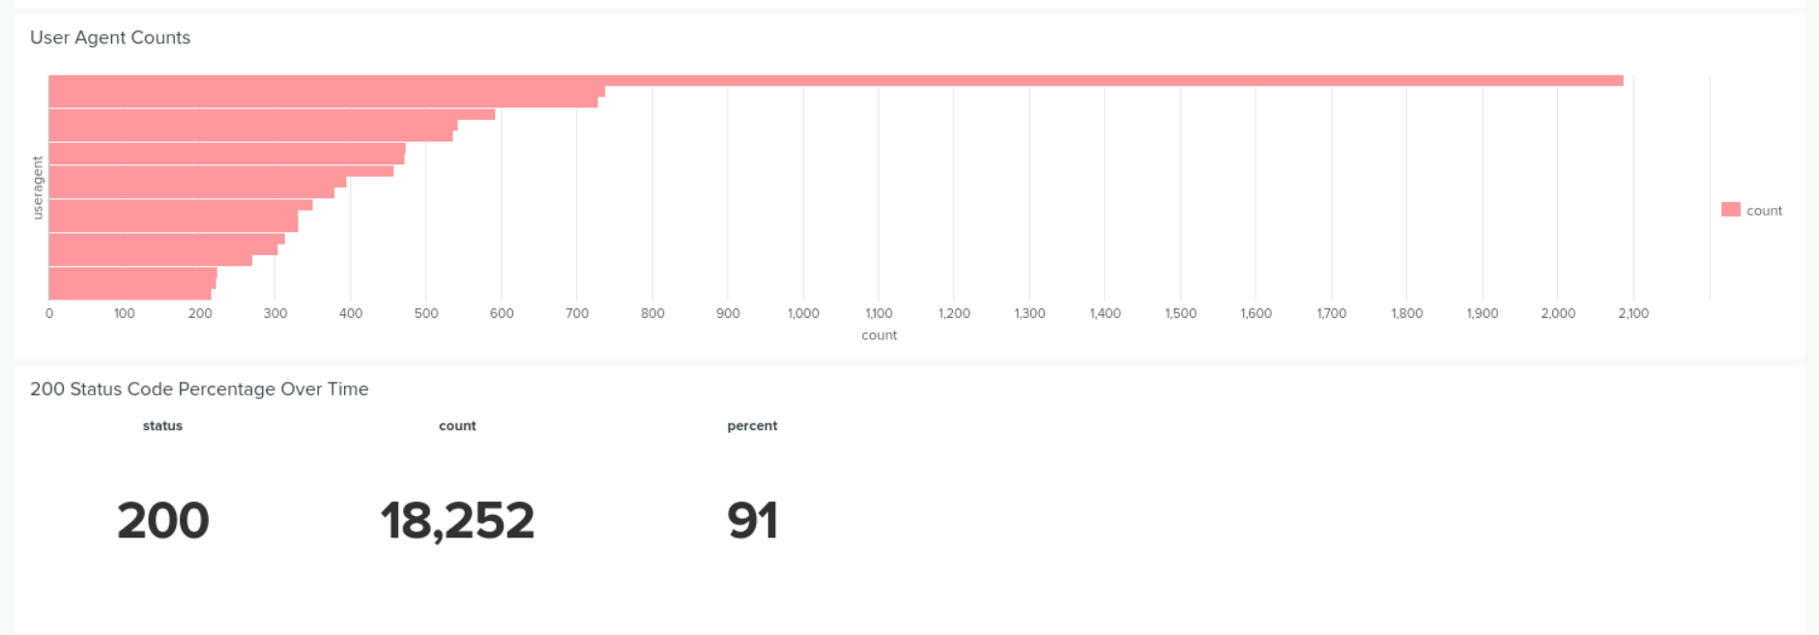
Dashboards—Apache
Place image here
Place image here
Place image here
Place image here
The Apache Server Monitoring Dashbaord that was constructed.

Slide 21
Attack Analysis
‹#›

Slide 22
Attack Summary—Windows
Findings from reports when analyzing the attack logs.
The High Severity Value rose from a count of 329 to 2,222. The informational Severity Value rose from a count of 4,435 to 8,766. There was a severe increase in High value information actions.
The failure count of activities went from 142 to 186 failures. The successful activity count went from 4,622 to 11,712. This suggests suspicious activity as there should be a similar increase in the rate of failures as there was in successful activities.

Slide 23
Attack Summary—Windows
Summarize your findings from your alerts when analyzing the attack logs. Were the thresholds correct?
Although there were 44 more failed activities, in one specific hour there were 56 failed activities. It would have passed the threshold of >10/hour for the alert action to have been triggered.
My alert would have been triggered as it exceeded the threshold by 60 events.
I would consider changing the threshold set previously after overlooking the data along with the new set of data. The previous threshold set seems to be more of a baseline. A new threshold of >20 events per hour is needed.
The majority of successful logins were not suspicious, except for one occurrence of >20 logins. My previous alert threshold of >25 events worked, I would not change it.

Slide 24
Attack Summary—Windows
Summarize your findings from your dashboards when analyzing the attack logs.
The signatures that stood out were “A user account was locked out.” and “An attempt was made to reset an account's password.”
The suspicious Users user_a and user_k stood out on the hourly search.
For user_a it began 2020-03-25 01:00:00 and stopped at 02:00:00. For user_k it began 09:00:00 and ended at 10:00:00.
User_a’s peak count was 1,968 while user_k’s peak count was 2,512.
At their respective times the user activity of user a and user k led to us believing they were the accounts used.

Slide 25
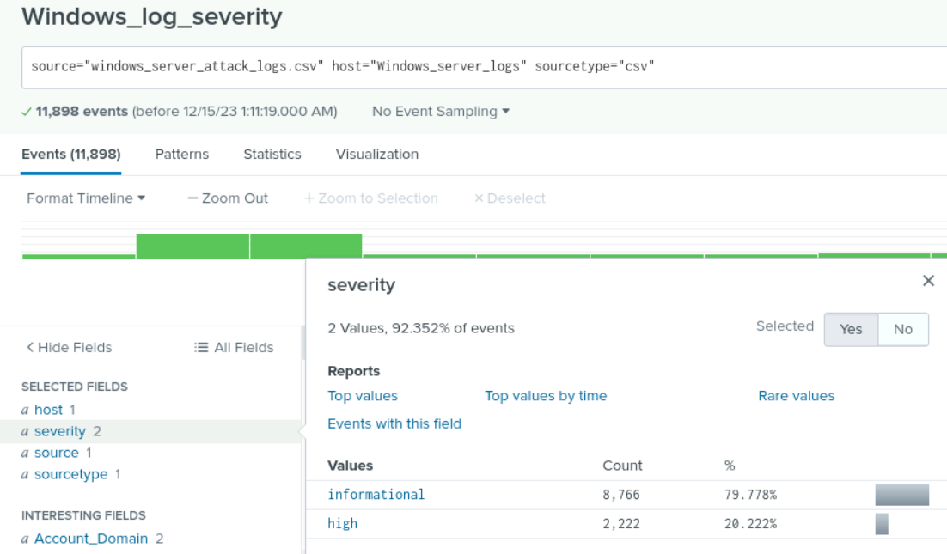
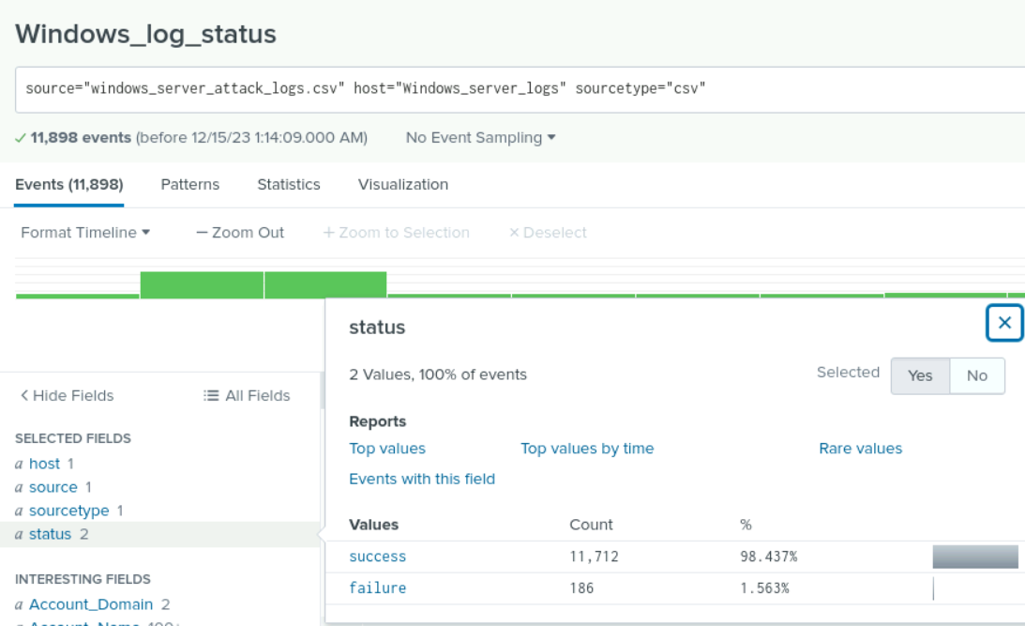
Screenshots of Attack Logs

Slide 26
Attack Summary—Apache
Findings from your reports when analyzing the attack logs.
The suspicious changes included GET requests falling significantly and then subsequently POST requests raised higher.
Traffic actually slowed down during certain hours leading to suspicion.
All reports showed a significant decrease in counts.
Findings from your alerts when analyzing the attack logs.
Activity from Ukraine was significant, HTTP POST requests rised significantly -into the thousands, I was not prepared for such a large increase in counts, my alerts can be adjusted.
Findings from your dashboards when analyzing the attack logs.
GET Methods were the most common HTTP activity, Accessing of logstash files, and major usage of the account logon page were used.

Slide 27
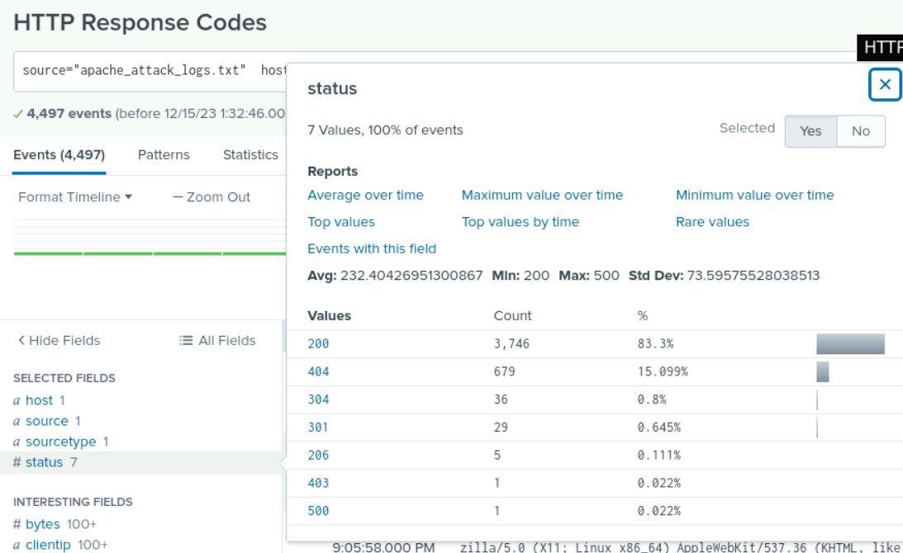
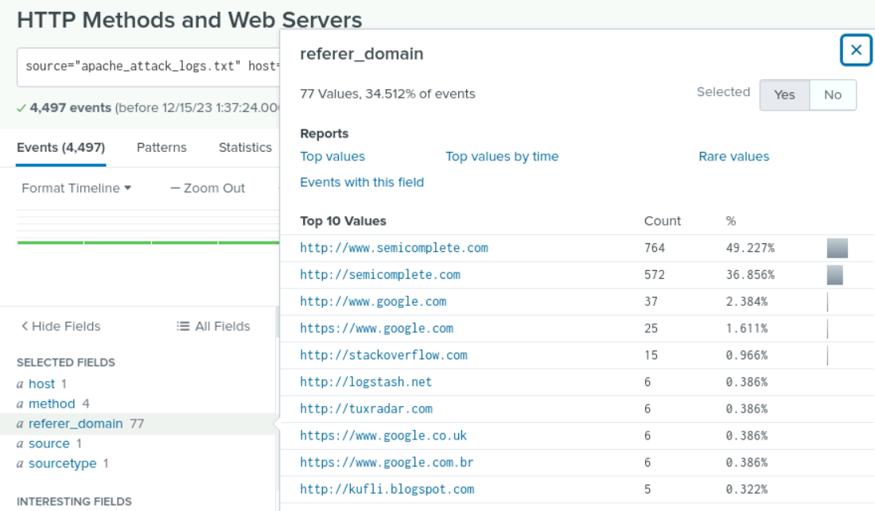
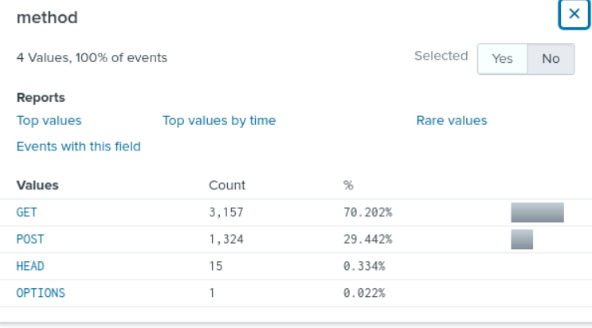
Screenshots of Attack Logs

Slide 28
Summary and Future Mitigations
‹#›

Slide 29
Project 3 Summary
What were your overall findings from the attack that took place?
The attacker is trying to automate the system's login attempts in an effort to complete a Brute Force attack.
To protect VSI from future attacks, what future mitigations would you recommend?
VSI can implement password regulations to lock out user after a certain amount of login attempts, successful or not.
(2FA) 2-Factor Authentication can be a successful tool to secure logins across the network.

